Slide 1
High-Speed AXI4-Lite Dynamic MAC Accelerator for RISC-V SoC Designs
SRIRAM N
Department of ECE
St. Joseph’s Institute of Technology
THIRUNAAVUKARASAN S
Department of ECE
St. Joseph’s Institute of Technology
Dr ROHINI G
Professor(Department of ECE)
St. Joseph’s Institute of Technology

Slide 2
Overview
Objective
Introduction
Need For System
Challenges
Related Works
Motivation
Proposed Methodology
Implementation
Result performance Metrics
Discussion
Conclusion
Acknowledgement
References

Slide 3
Objective
Design a high-throughput Dynamic Precision Multiply–Accumulate (MAC) architecture capable of adjusting its arithmetic precision (8/16/32-bit) and processing latency according to workload requirements.​
Integrate the MAC unit seamlessly with an AXI4-Lite interface to enable programmable control, configurability, and SoC-level reusability.
Optimize the architecture for RISC-V-based systems, emphasizing minimal resource footprint while sustaining deterministic performance.
Demonstrate measurable improvements in latency, energy efficiency, and computational accuracy compared to static, fixed-precision MAC designs.
Establish a scalable hardware framework suitable for emerging edge-AI, DSP, and embedded compute workloads requiring flexible arithmetic pipelines.

Slide 4
Introduction
Modern embedded and edge-AI systems demand arithmetic units that balance speed, accuracy, and power—far beyond what fixed-precision MACs can offer.
Traditional MAC architectures struggle with varying workload characteristics, leading to unnecessary latency, energy waste, or degraded numerical quality.
Dynamic MAC designs introduce adaptive computation paths, enabling real-time precision control and performance scaling.
Integrating such a MAC within an AXI-based RISC-V SoC provides a programmable, lightweight accelerator accessible through standard interfaces.
This project explores a unified hardware approach that elevates MAC flexibility while maintaining SoC compatibility and implementation efficiency.

Slide 5
Challenges
Balancing precision adaptability with hardware simplicity without inflating LUT, DSP, or timing overheads.
Maintaining stable throughput while switching between static and dynamic MAC modes under diverse input patterns.
Designing an AXI4-Lite control path that remains lightweight yet expressive enough to configure multiple operational parameters.
Ensuring deterministic latency behavior in a pipeline that inherently supports variable computational depths.
Integrating the accelerator cleanly into a RISC-V SoC without compromising system clock, memory bandwidth, or verification complexity.

Slide 6
Related Work
Locatelli et al. (2023) proposed a fully time-domain MAC unit that performs multiplication and accumulation using temporally encoded pulses, enabled by a time-register–based architecture. Implemented in 180-nm CMOS, the design occupies only 3167 μm², consumes 1.72 mW, and achieves under 5% error across a 19-ns dynamic range with R² > 0.99, demonstrating an efficient low-power alternative for DSP, IoT, and ML applications.
Alsayyab et al. (2022) presented a floating-point MAC for neural networks, featuring optimized mantissa multiplication and pipelined IEEE-754 datapaths. Their work demonstrates the hardware cost and design considerations needed to achieve high-precision arithmetic on FPGA platforms.
Devic et al. (2021) proposed a mixed-precision, energy-efficient MAC for edge ML, enabling asymmetric bit-widths up to 32 bits. Synthesized in 28 nm FD-SOI, the design achieves notable savings in area and power, evidencing the value of precision-scalable arithmetic in resource-constrained systems.
Orugu et al. (2024) explored an approximate radix-8 Booth multiplier optimized for image-processing pipelines. Their results show improved delay and resource efficiency while maintaining high output quality, demonstrating how approximate and Booth-based techniques can enhance arithmetic performance on an FPGA.

Slide 7
Motivation
Fixed-precision MAC units limit performance, accuracy, and energy efficiency when operating across diverse embedded and ML workloads.
Emerging RISC-V SoCs require lightweight, configurable accelerators that avoid DSP overuse and adapt to varying computational demands.
Dynamic precision control enables meaningful reductions in switching activity, latency, and power—critical for edge devices operating under strict resource budgets.
A programmable AXI-based MAC unit offers a reusable, SoC-friendly alternative to static datapaths and vendor-specific DSP blocks.
Modern applications—from quantized inference to DSP preprocessing—benefit directly from MAC architectures that scale their computational depth at runtime.

Slide 8
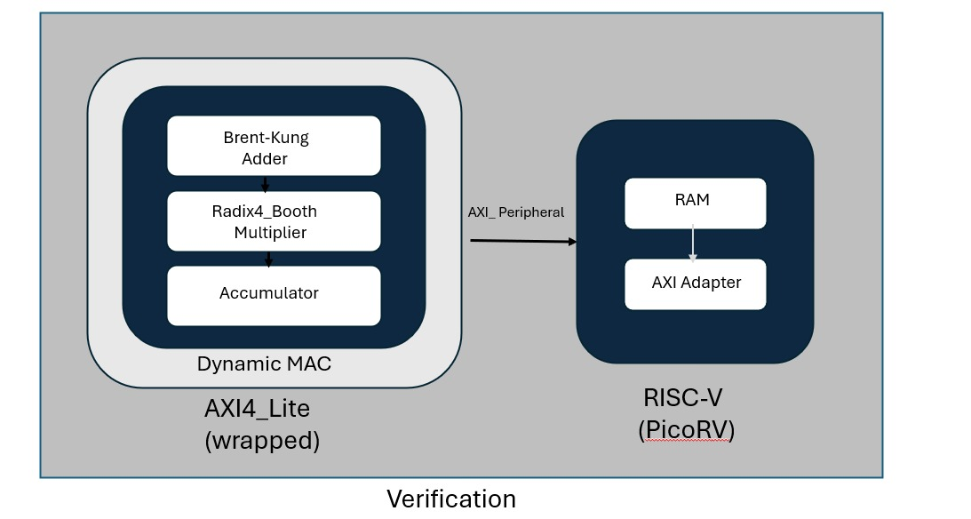
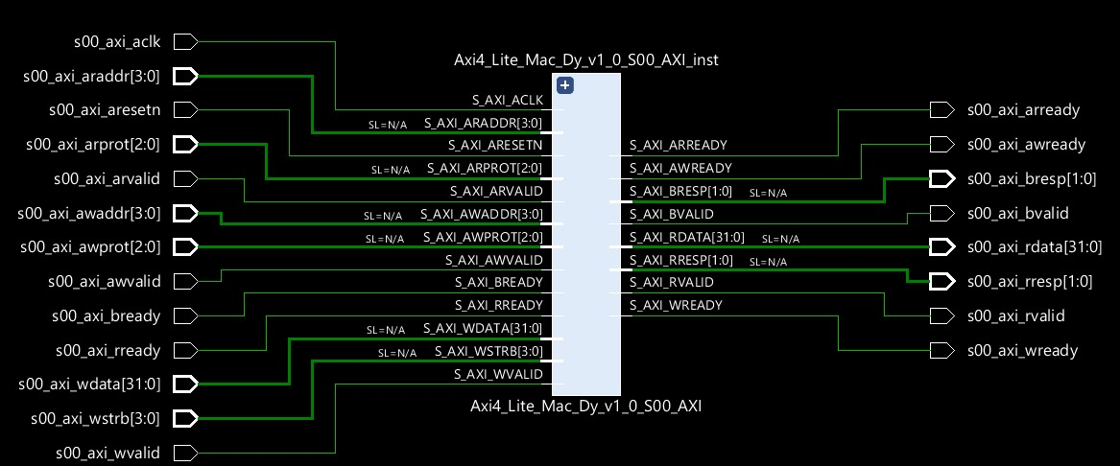
Proposed Methodology

Slide 9
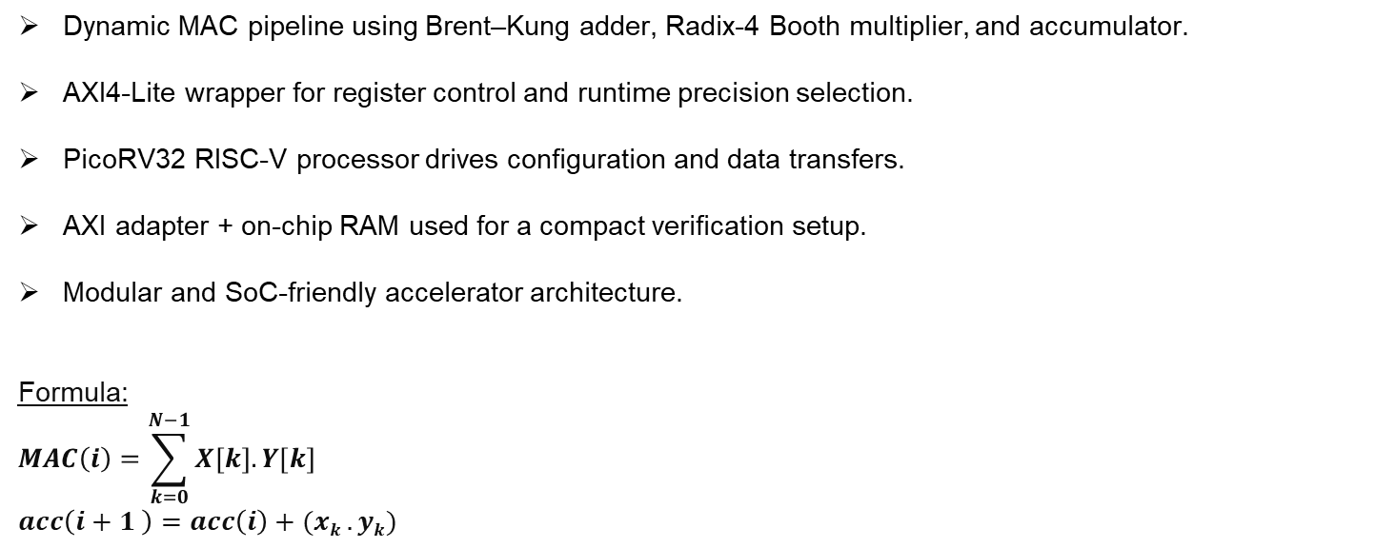
Proposed Methodology
Dynamic MAC pipeline using Brent–Kung adder, Radix-4 Booth multiplier, and accumulator.
AXI4-Lite wrapper for register control and runtime precision selection.
PicoRV32 RISC-V processor drives configuration and data transfers.
AXI adapter + on-chip RAM used for a compact verification setup.
Modular and SoC-friendly accelerator architecture.
Formula: $$MAC\left(i\right)=\sum_{k=0}^{N−1}{X\left[k\right].Y[k]}$$
$$acc\left(i+1 \right)=acc\left(i\right)+(xk .yk)$$
Mode | Meaning | Value to write
0 | 8- Bit precision | 0x00
1 | 16- Bit precision | 0x01
2 | 32 - Bit precision | 0x02

Slide 10
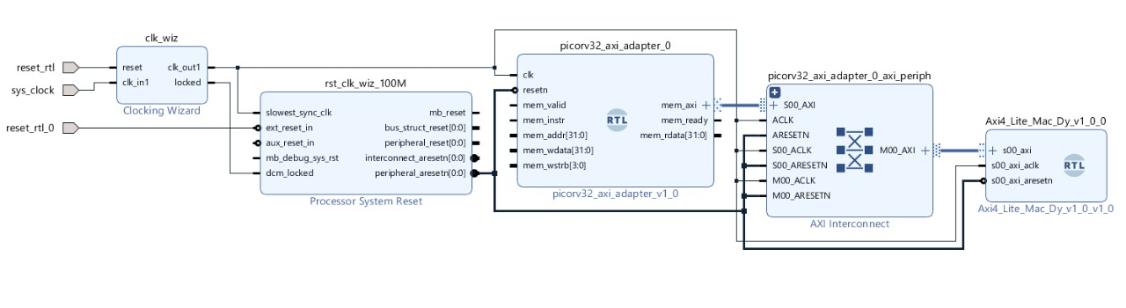
Implementation

Slide 11
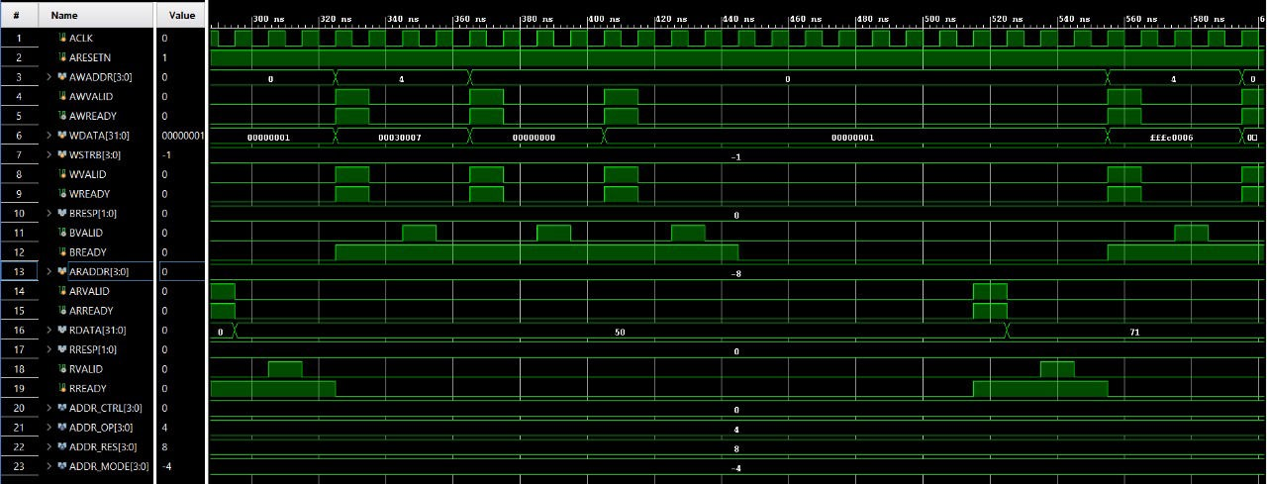
Result & Performance Metrics
AXI wrapped MAC unit waveform

Slide 12
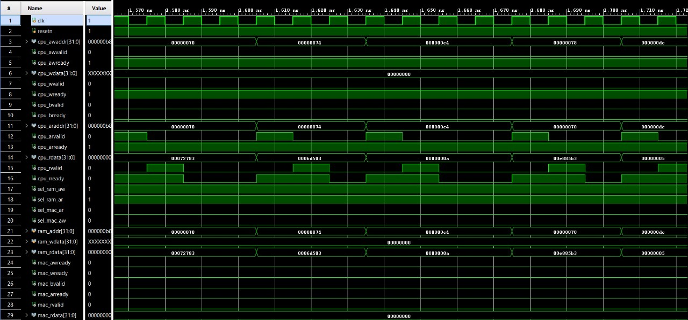
Result & Performance Metrics
CPU → RAM → MAC interactions

Slide 13
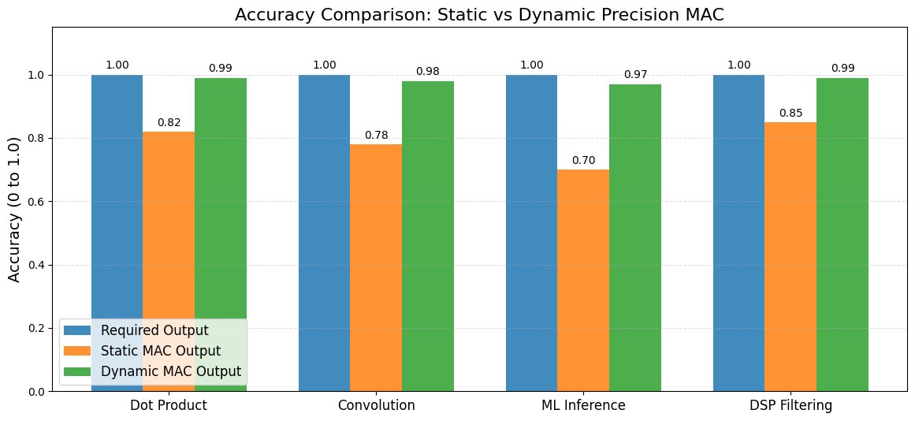
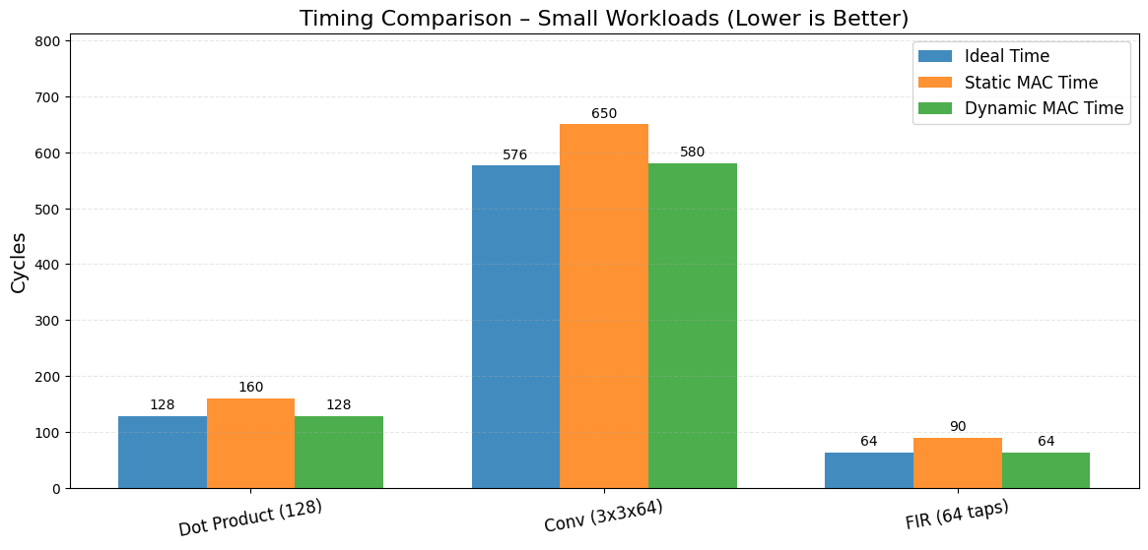
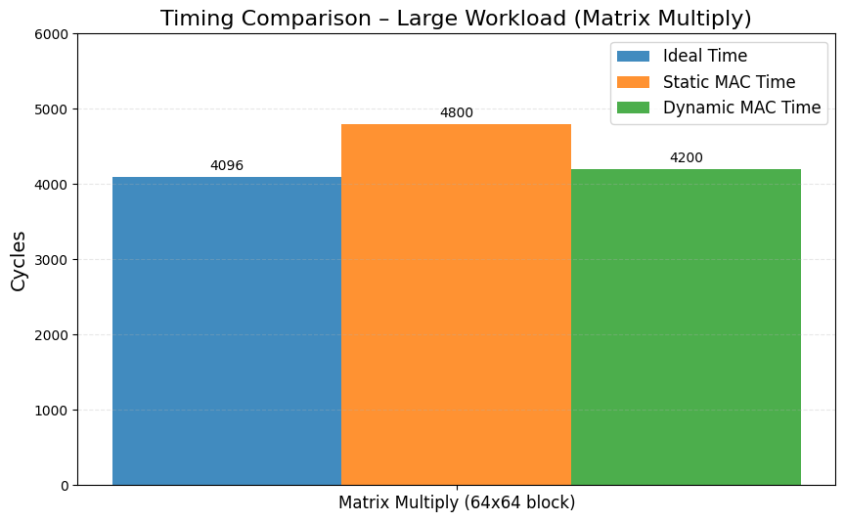
Result & Performance Metrics

Slide 14
Conclusion
Demonstrated a dynamically configurable MAC unit that adapts precision and latency to workload demands while maintaining AXI compliance.
Integrated seamlessly with a RISC-V (PicoRV32) system, enabling programmable control, efficient data movement, and a compact verification flow.
Achieved improved flexibility and computational efficiency compared to static MAC architectures, validating the value of scalable arithmetic pipelines.
NOVELTY HIGHLIGHTS:
Introduces a runtime-configurable MAC pipeline that supports multiple precision modes (8/16/32/40-bit) without relying on DSP slices.
Combines Brent–Kung addition and Radix-4 Booth multiplication within an AXI4-Lite–controlled architecture, enabling adaptive high-speed arithmetic.
Provides a fully integrated RISC-V (PicoRV32) verification framework, demonstrating seamless processor–accelerator interaction in a compact SoC environment.

Slide 15
References
M. R. P. C. Muhammed et al., “Dynamic Precision Scaling in MAC Units for Energy-Efficient Computations in Deep Neural Network Accelerators,” Proc. 28th Int. Symp. VLSI Design and Test (VDAT), 2024.
G. Devic et al., “Highly-Adaptive Mixed-Precision MAC Unit for Smart and Low-Power Edge Computing,” Proc. 19th IEEE NEWCAS, 2021.
P. S. Locatelli et al., “Time-domain multiply–accumulate unit,” Apr. 2023.
Sabreen Alsayyab and A. J. M. Karkar, “FPGA Implementation of MAC Unit for Artificial Neural Network Accelerators,” IEEE, 2022.
Rangarao Orugu et al., “FPGA Design and Implementation of Approximate Radix-8 Booth Multiplier,” 2024.
S. V. Kartheek et al., “An Optimized Multiply Accumulate Unit for Embedded Applications,” Proc. ICAECT, 2025.
M. Jayasanthi and D. Ashvika, “Implementation of Power Efficient Multiply Accumulate Unit for DSP Applications,” Proc. iTech SECOM, 2023.
R. Chandaluri and U. Nelakuditi, “Design and Implementation of AXI4-Lite Interface in Zynq SoC,” Proc. DELCON, 2022.
Aashima and L. M. Saini, “Design, Analysis and Verification of AMBA AXI4.0,” Proc. ICVADV, 2025.
RISC-V Instruction Set Manual, Volume I – Unprivileged Architecture, RISC-V International, 2024.

Slide 16
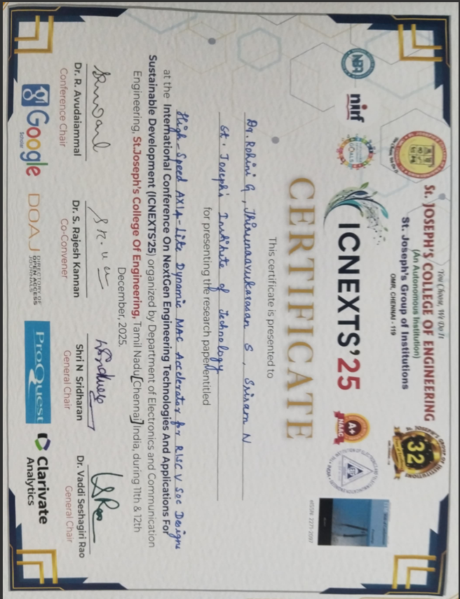
Certificate

